Slide 1
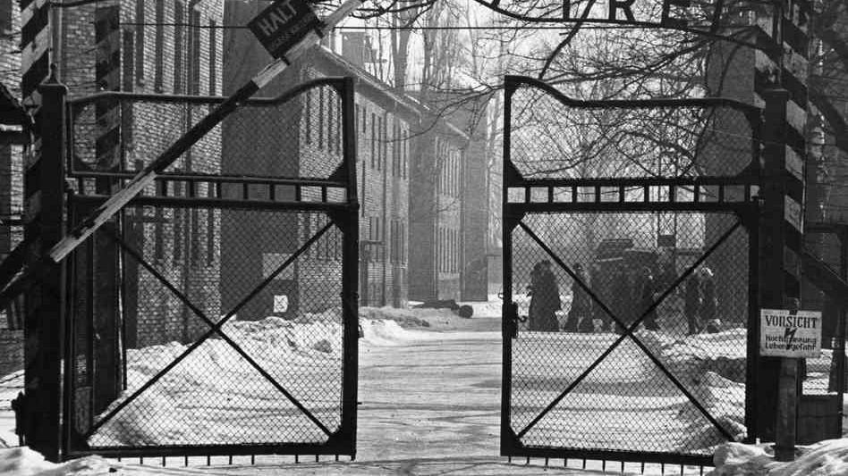
An everyday man turned volunteer for Auschwitz?

Slide 2
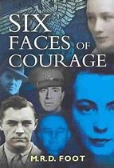



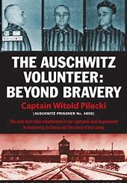
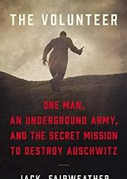
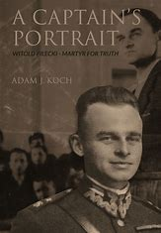
For years in oblivion
Józef Grliński’s Ph.D. 1973
Discovered little by litlle in the west
Censored in Poland
Becomes an inspiration for writers in Poland and abroad
http://rtmpilecki.eu/
raport-3/

Slide 3
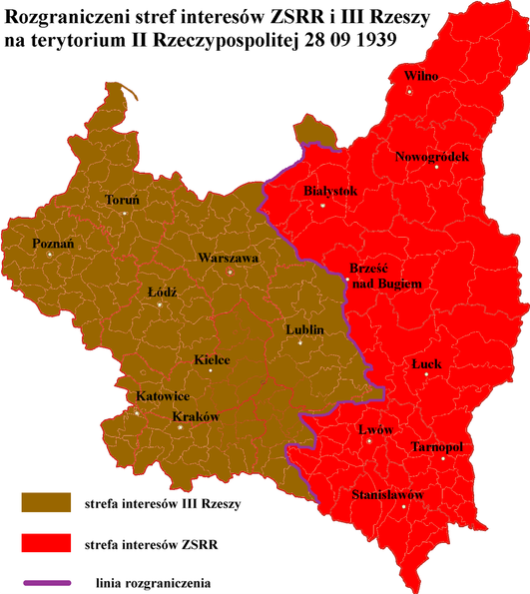
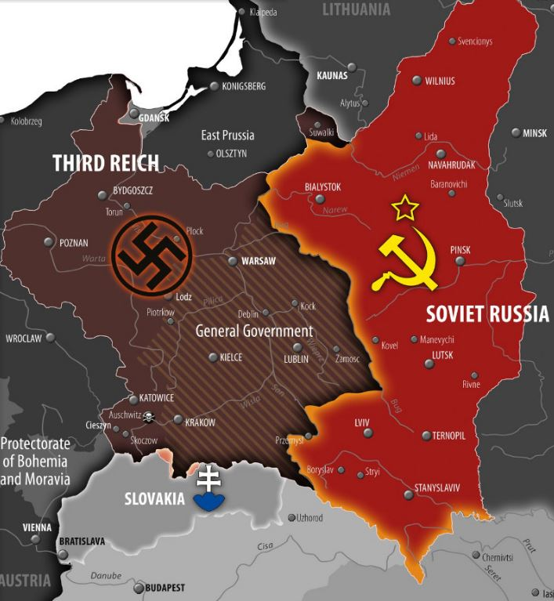
Lieutenant in the 26th Lancers’ Regiment
September 1939:
Poland attacked and defeated by Germany and the Soviet Union
Subsequent division into two occupation zones, the Nazi German and the Soviet one
German zone divided into the lands directly incorporated into the 3rd Reich and the General Gouvernment

Slide 4
Secret Polish Army
September campaign
Decision to go into hiding
Founding member of Secret Polish Army [Tajna Armia Polska]
Organizational work in Warsaw
Volunteering for Auschwitz to gather intelligence about the camp and build an underground resistance there

Slide 5
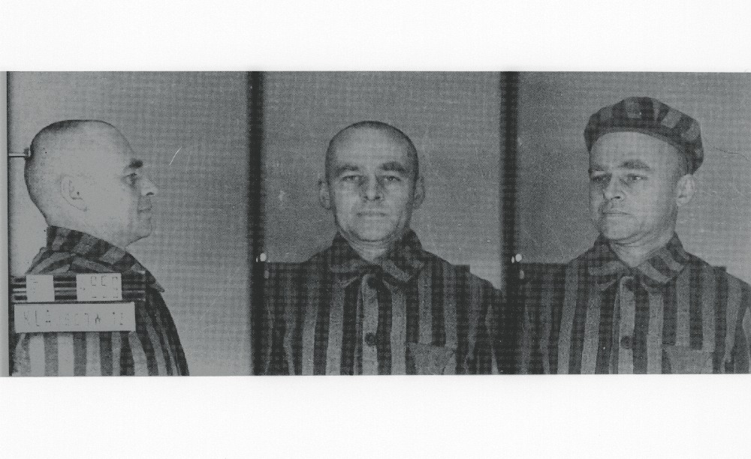
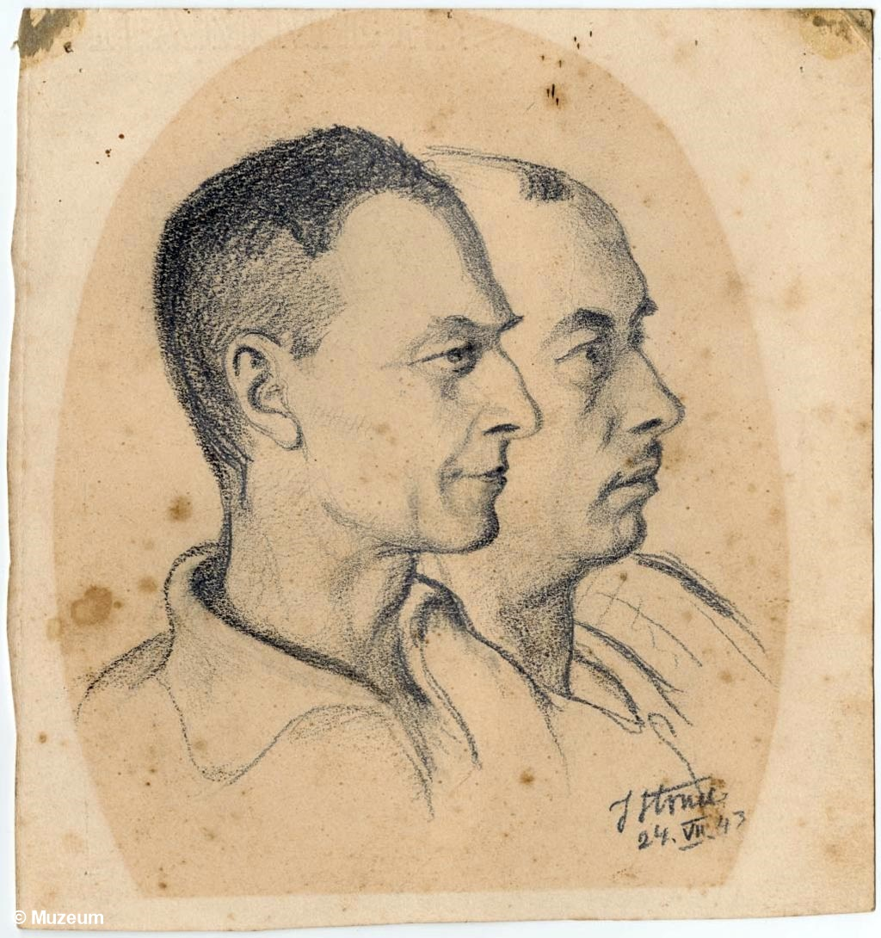
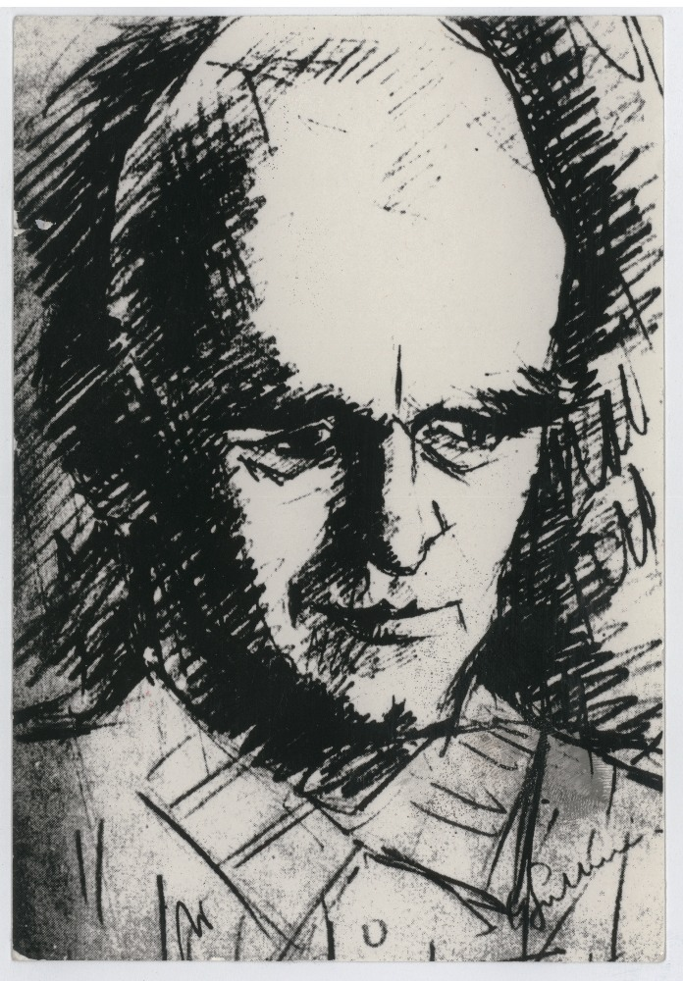
Volunteer for Auschwitz
Joined 2nd Warsaw round-up
Arrived at the camp on 22 Sept 1940
No. 4959
Assumed identity of Tomasz Serafiński
“Outlandish reality”
2 tasks: to survive and to work
22 September 1940 - 26 April 1943

Slide 6
Surviving
Avoiding death through punishment or overwork
Finding a job under a roof
Finding a more influential job
Finding food
Surviving disease
Gradually improving conditions for inmates

Slide 7
Organizing
infirmary for inmates
Arbeitseinsatz – office assigning inmates to Kommandos
carpentry, tannery, clothing magazine and
vegetable-sorting magazine
Five initial „fives” organized by November 1941
ZOW Związek Organizacji Wojskowej Military Organization Union
Reporting
Counterespionage
Escapes
Help to the women’s camp in Birkenau

Slide 8
Reporting
Network of ZOW members in all Arbeitskommandos
Regular dispatches to the Union of Armed Struggle/Home Army in Warsaw
Through people released from Auschwitz and later escapees
Subsequently sent to London
Allies were being regularly informed about the developments in Auschwitz by Polish intelligence sources
Pilecki Reports – 3 summary reports on Pilecki’s work: 1943, 1945

Slide 9
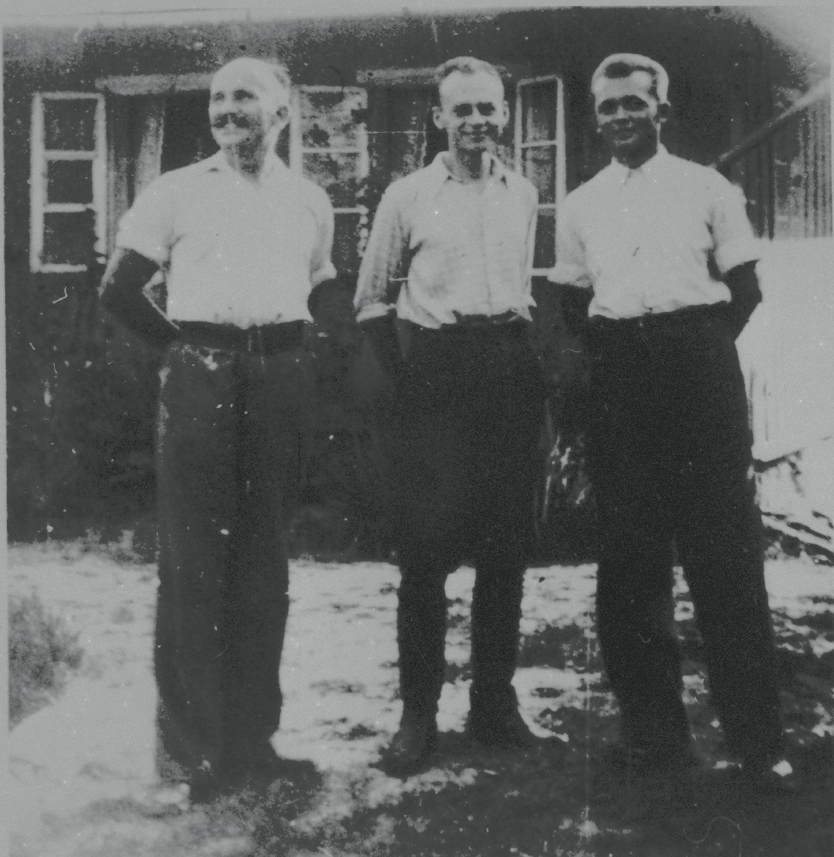
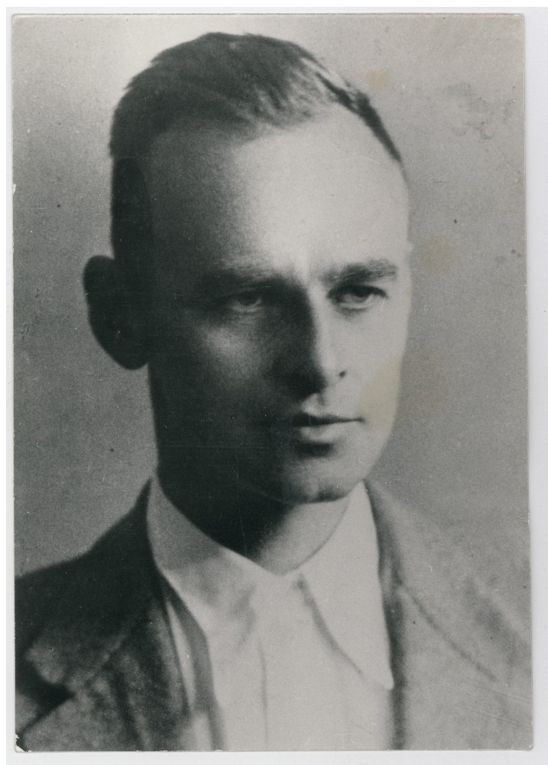
Escape 26/27 April 1943
With Jan Redzej and Edward Ciesielski
Through the bakery
One-time chance
A number of wonderous coincidences
Meeting the true Tomasz Serafiński
The first Pilecki report

Slide 10
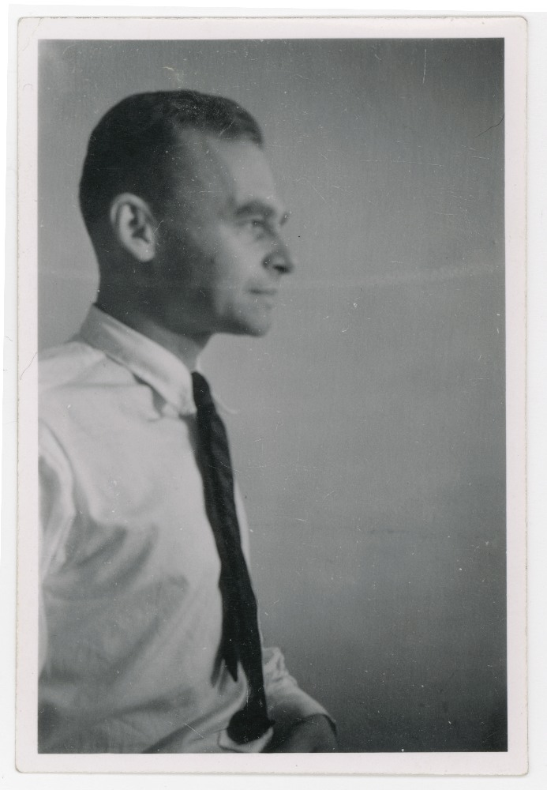
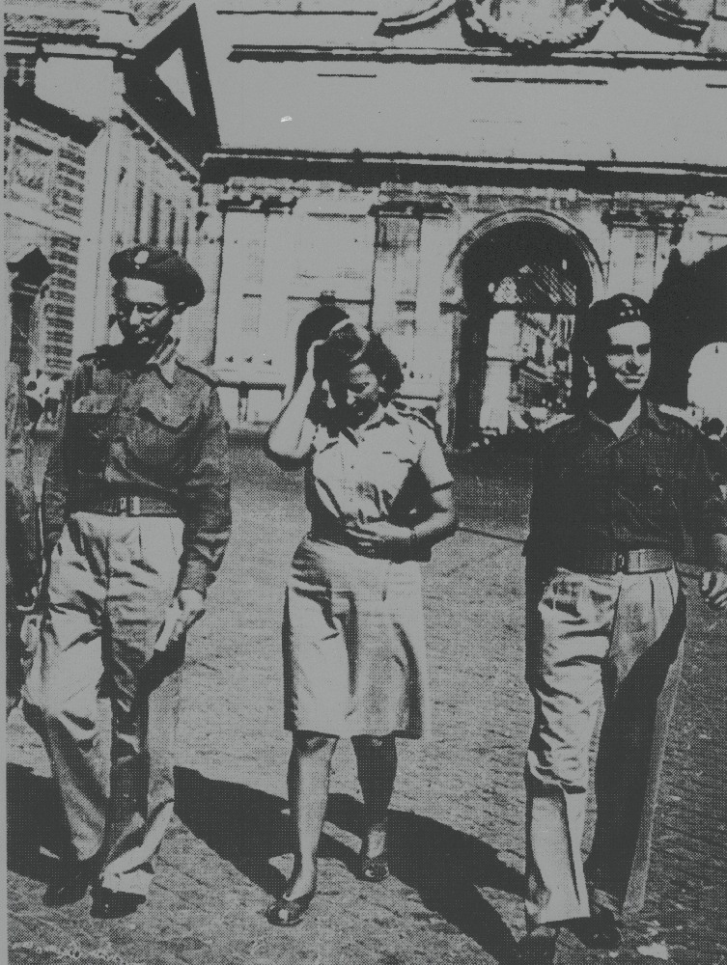
Further Wartime Activities
Back to work in intelligence: Niepodległość – NIE
Warsaw Uprising
Murnau POW camp
2nd Polish Corps in Italy (Porto San Giorgio and Pilecki Report 1945)

Slide 11
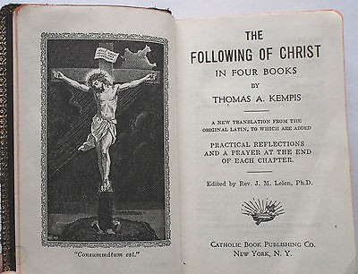
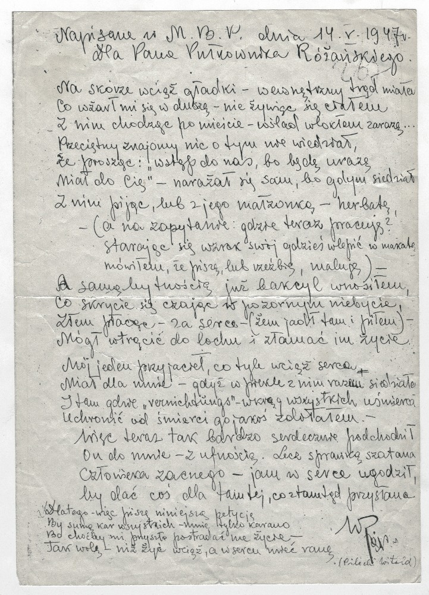
investigation with torture
May 13, 1947 –
December 3, 1947
A letter-poem to Colonel Różański 14 May 1947
Różański hides Witold’s Report
Taking the blame solely on himself
The indictment (December 11, 1947) The introduction to it prefigurated the reasoning of the authorities at the trial.
Pilecki’s group = „an espionage ring managed by the residents of the intelligence of the General Anders’ Second Corps, whose aim was to inform Anders’ Corps about the entirety of political changes in Poland on the basis classified civilian and military information and documents.”

Slide 12
investigation with torture
May 13, 1947 –
December 3, 1947
Although my skin was unblemished – my soul
Has been eaten by leprosy – but leaving the body alone
Walking the streets I carried – the plague within me…
Unbeknownst to a friend, who insisted on me
Joining him and his wife for an afternoon tea,
He endangered himself with his all family –
So I sat there – a cup in my hand – (avoiding their eyes
When asked about my profession, mentioning
Writing, painting or sculpting as my occupation) –
‘Twas enough for me to enter to spread a germ to their home
Seemingly non-existent – the dark token of my gratitude
In exchange for the food, shared so gladly,
I could break their lives, send them to a dungeon.
One of my friends opened to me his whole heart
because I met him in hell and helped him survive
in spite of “vernichtungs” there sparing no human life.
But by devil’s doing I was to betray the trust
Of that kindest man just to give certain thing
for a woman sent from the outer of here.
That is why in this very petition I would like to request
To be the sole sentenced to all punishments.
For even if I am to lose my life in this way –
I would much rather do so than continue to live
Wounded at heart.
A letter-poem to Colonel Różański 14 May 1947
Written at the Ministry of Public Security May 14, 1947
For Mr. Col. Różański

Slide 13
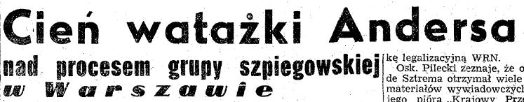
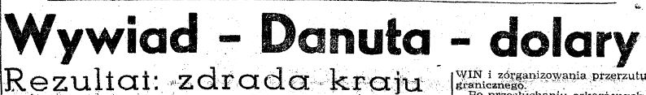
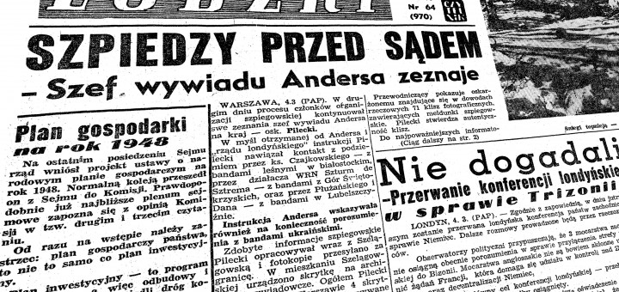
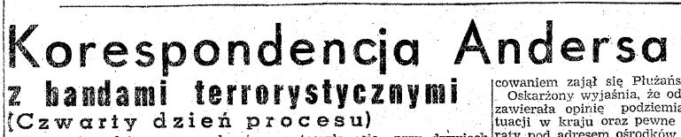
“General Anders’ Spy”
The show trial of 2 weeks
Witch hunt in the media (radio, press)
Features characteristic for the Soviet-designed show trials

Slide 14
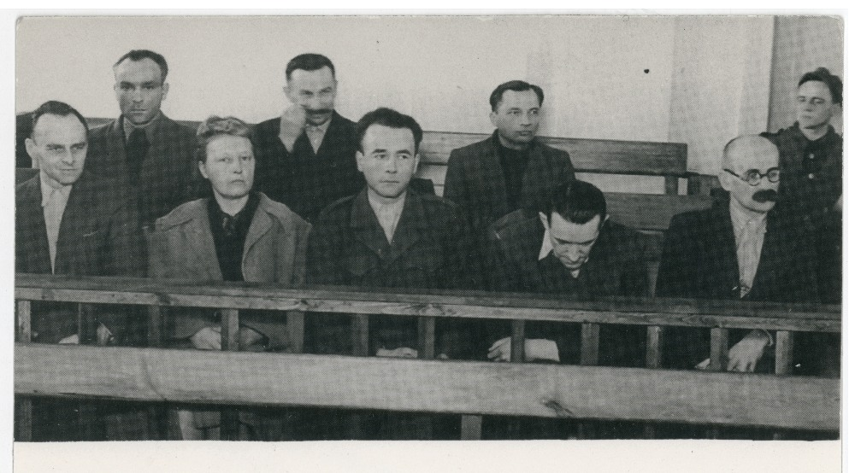
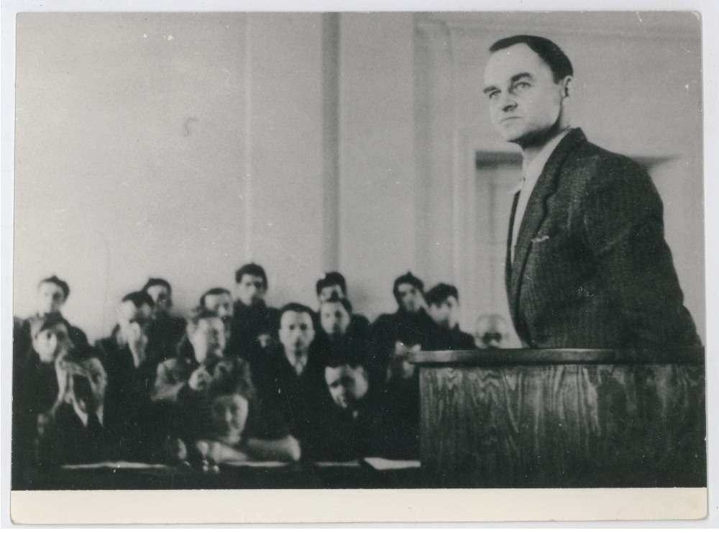
The Trial of the
„Witold Group”
March 3, 1948
One of the series of show trials aimed at the intimidation of the Polish independence underground and the Polish populace
Element of terror
Pilecki’s valiant past not mentioned
“I feel very tired already and I want a swift ending”
Witold Pilecki

Slide 15
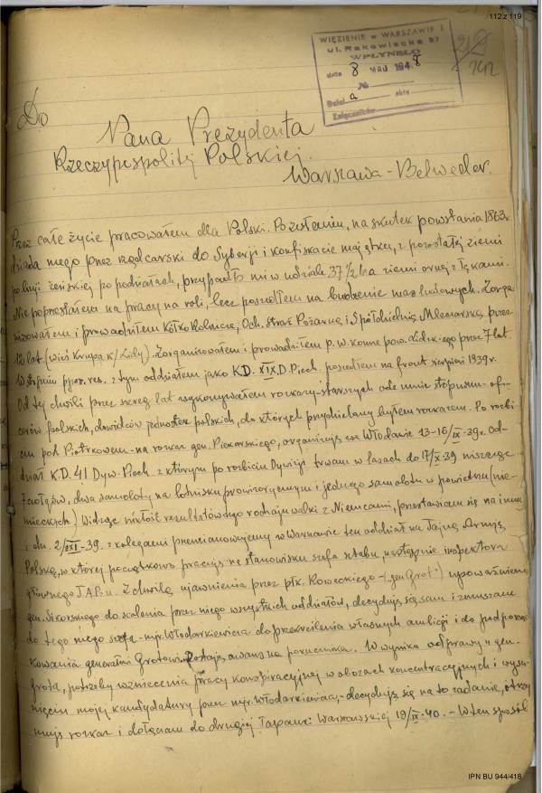
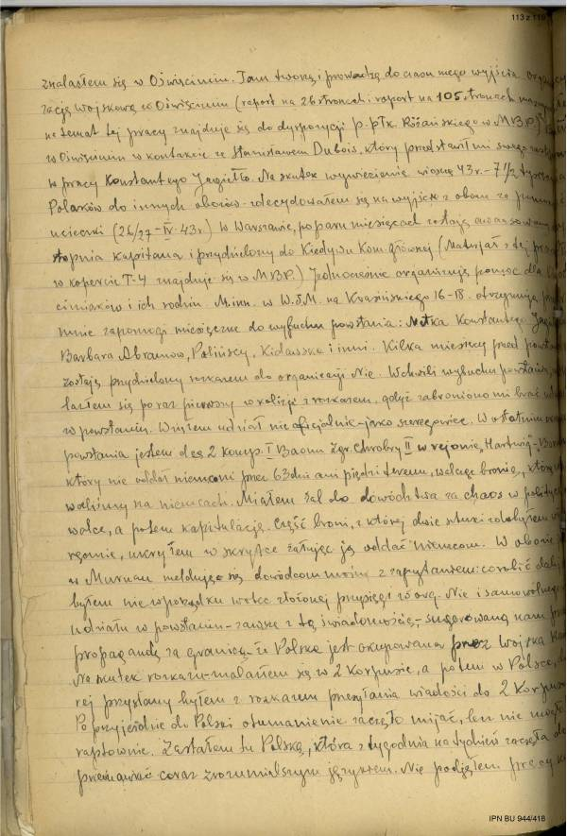
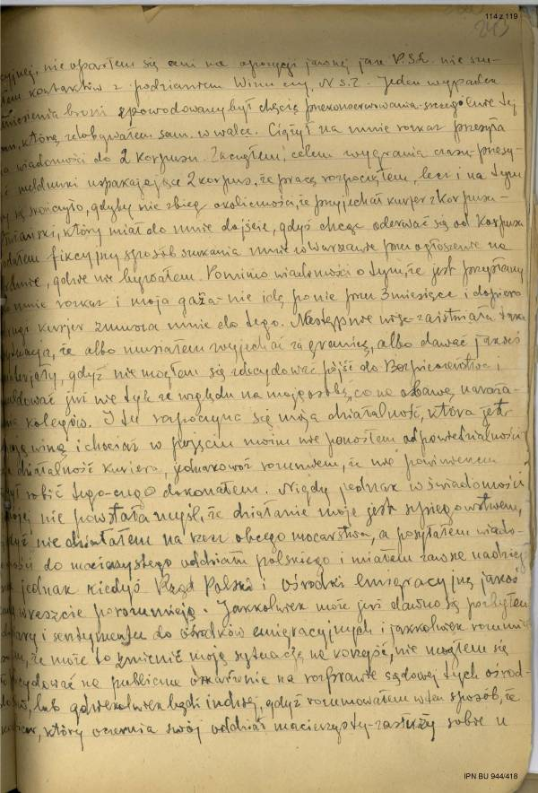
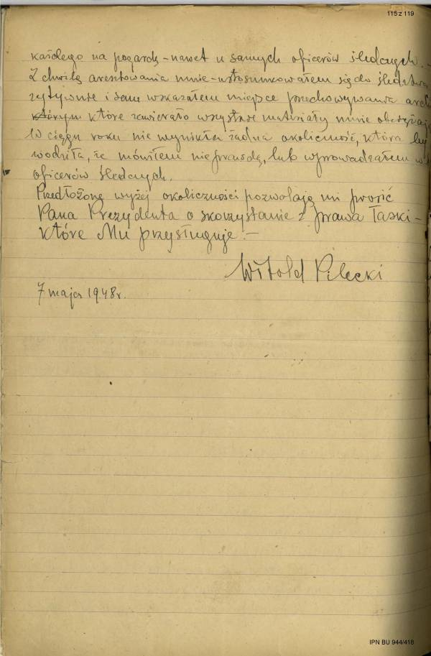
„All my life I have worked for Poland”
Pilecki’s clemency plea rejected
His wife and Auschwitz inmates’ pleas rejected
Notes:
To you, Mr. President, as a man […] knowing all the pain, traumas and doubts of all the Poles, I and my children address our heartfelt plea to use your presidential clemency prerogative towards our husband and father, Witold Pilecki, who has been sentenced to death.
For a long time, the hope of the future peaceful life with him was what kept us alive. We had not only love for him but also a devotion. He loved Poland with a love beyond all else.
Until 1944, the fight for the liberation of the nation had filled his life. He worked clandestinely by way of the order of his superiors, he left for Auschwitz in order to organize a resistance organization there against German bestiality, to save human life. Having escaped from the camp, he devoted himself entirely to the pro-independence work, finalized by his participation in the Warsaw Uprising. We remained separated for nine years. All those deeds gave us strength to persevere and hope for the future life together […] We beg […] for mercy for our father and husband.

Slide 16
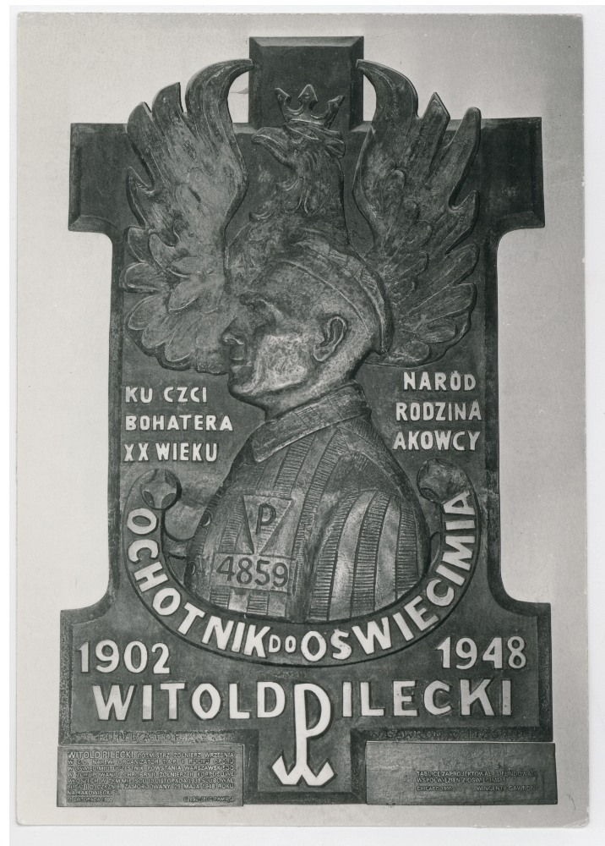
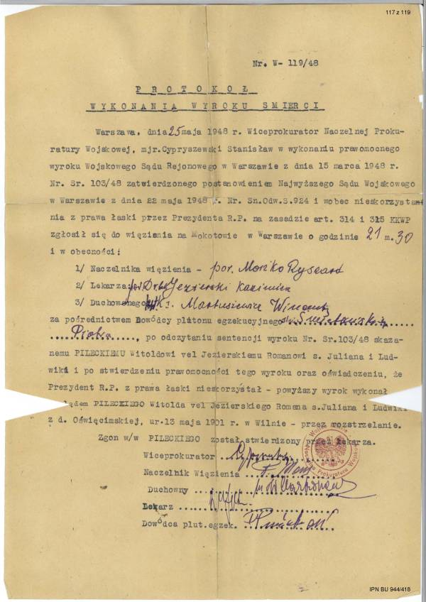
Capital punishment May 25 1948
Family found out after the files were located in the UOP files in 1990
News about him was censored till about the late 1970s
His family was persecuted throughout the duration of the Polish People’s Republic
His grave has still not been located

Slide 17
Pre-World War II intelligence activity
”From the three stars of a captain in 1939 to the very same three stars of a rotamaster in 1943, I have gone long and difficult enough a way. Working before the war of 1939 in a certain cell, I was promoted under an assumed name. For better cover, I was officially a reserve lieutenant of the 26th Lancers Regiment.”

Slide 18
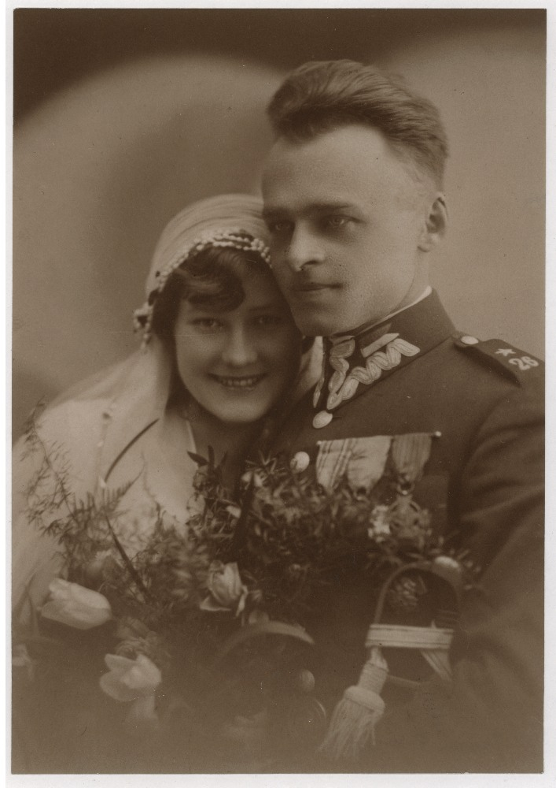
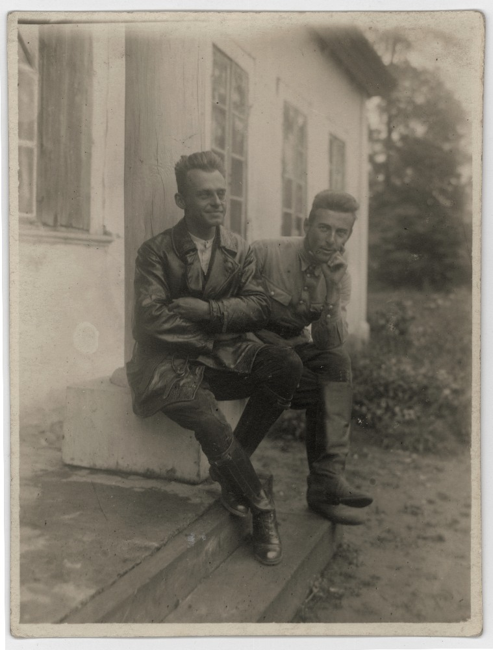
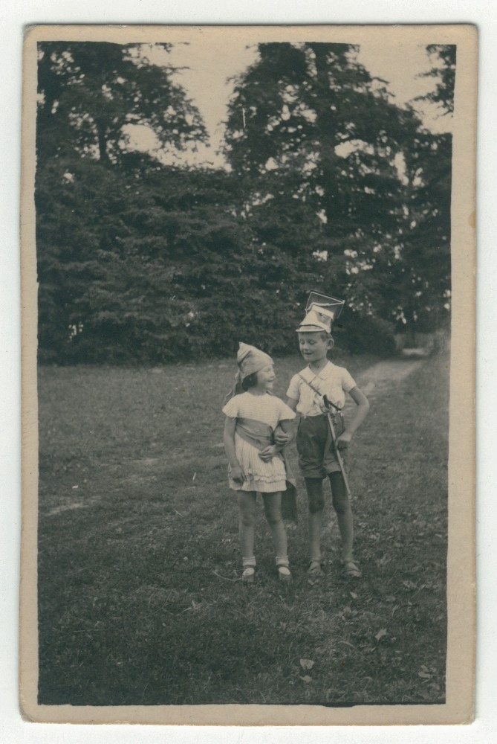
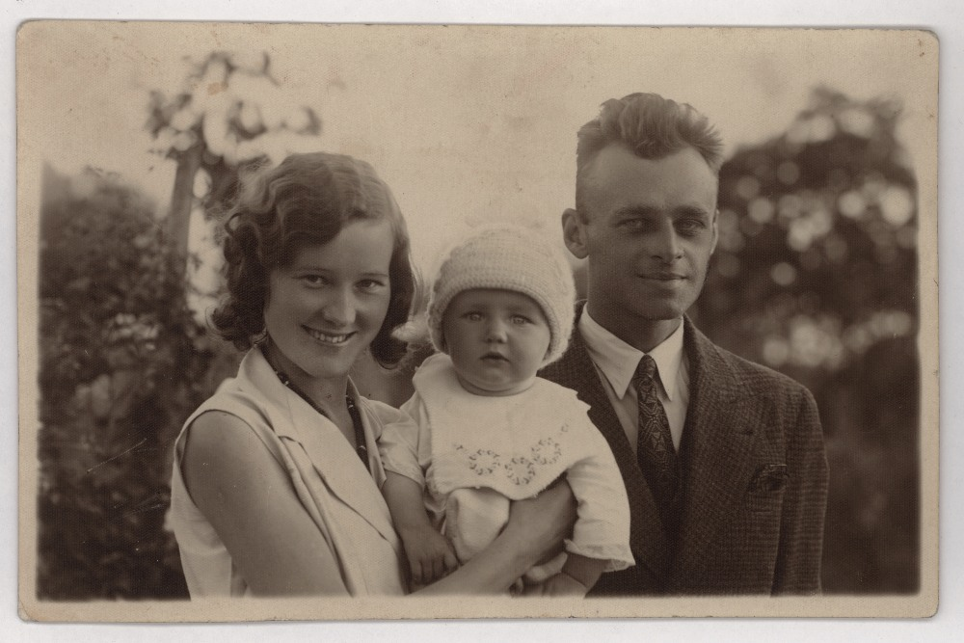
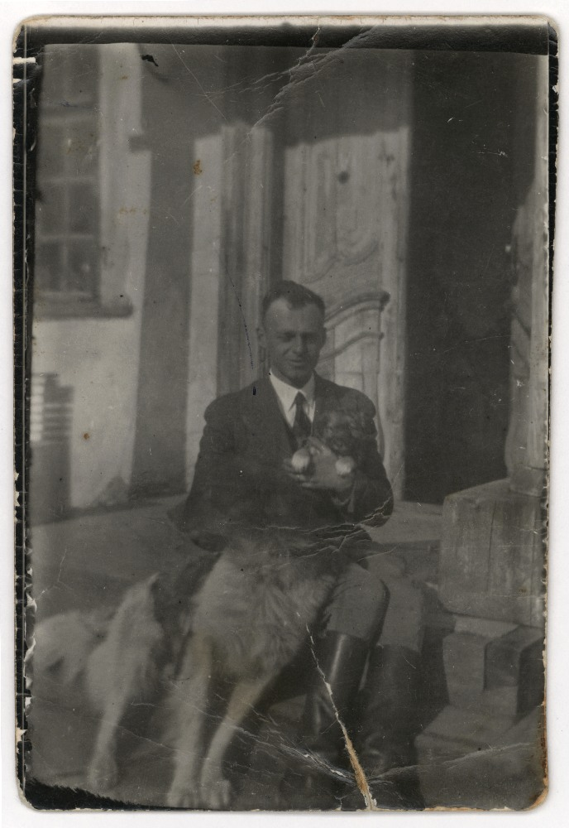
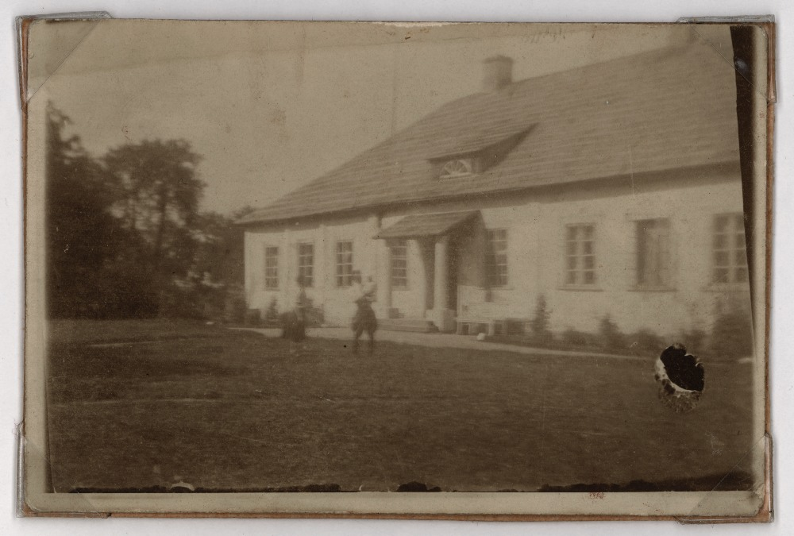
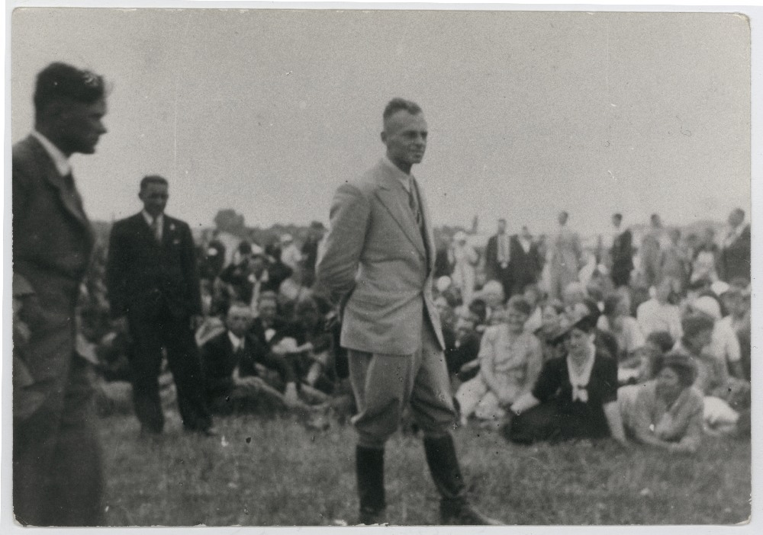
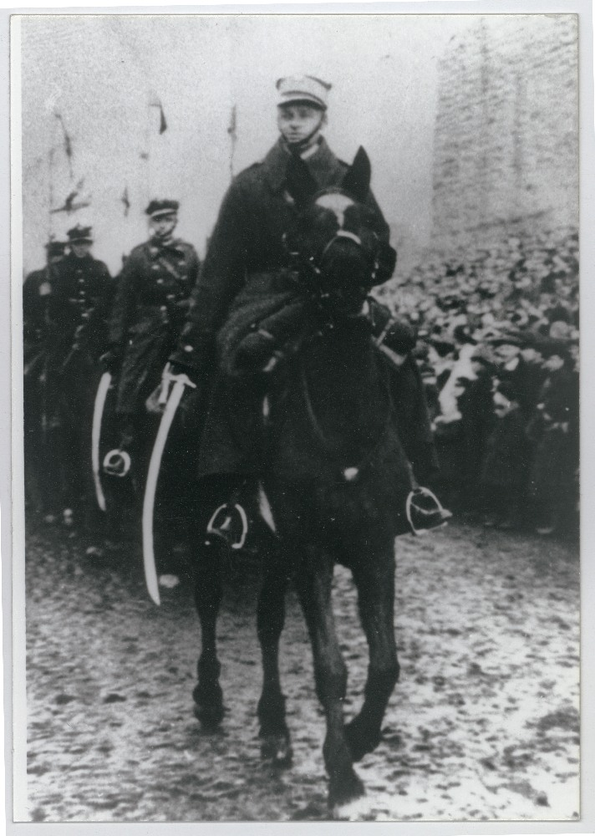
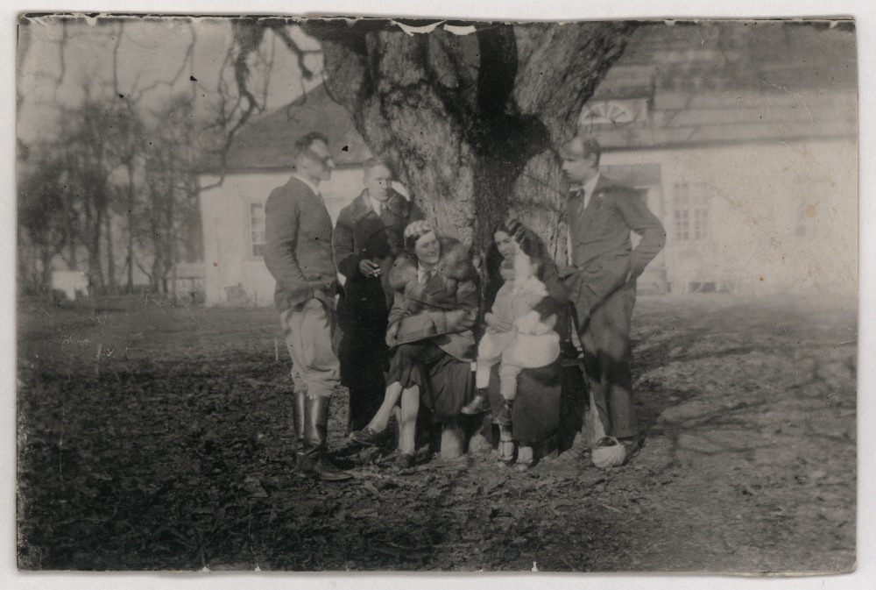
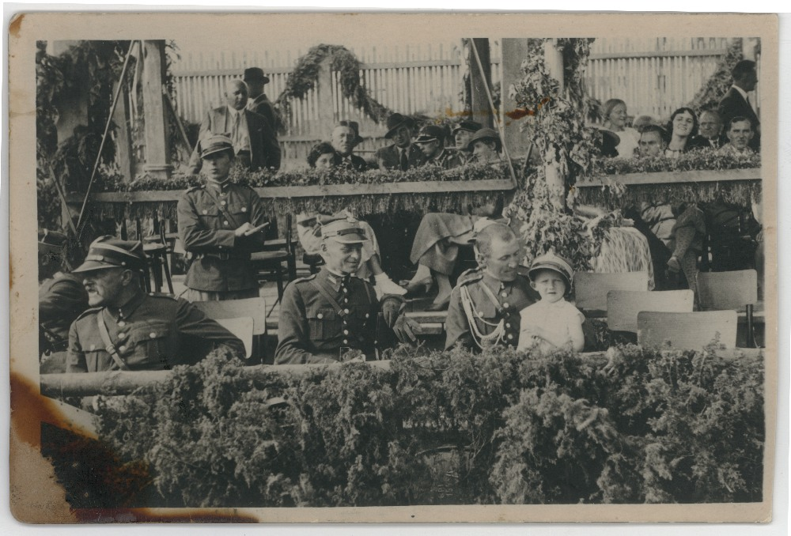
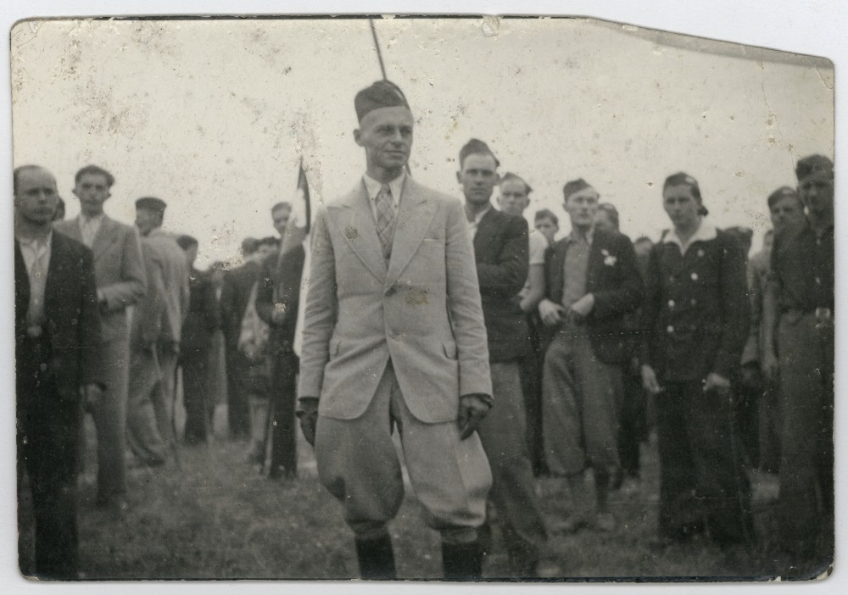
The Man of Renaissance
Land owner
Innovator
Community leader
Educator
Entrepreneur (dairy cooperative)
Dotting father
Mounted militia commander
Artist (painter, artistic carpenter)
Poet
Recipient of the order of merit

Slide 19
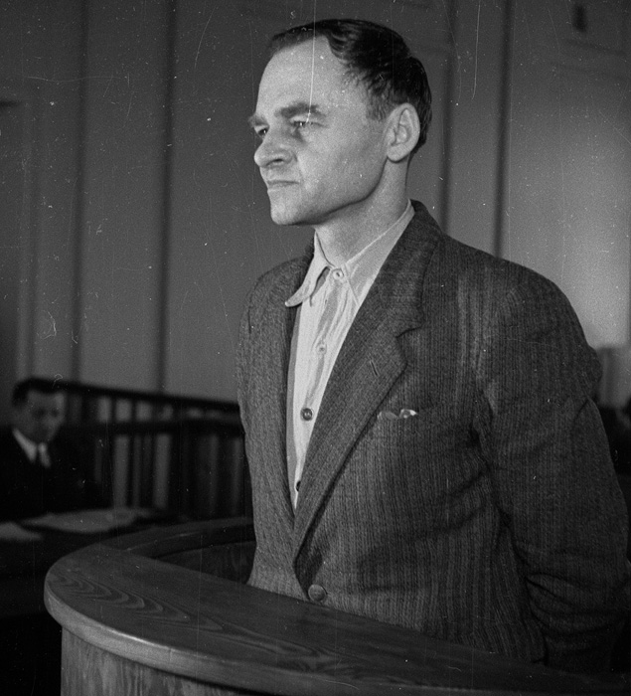
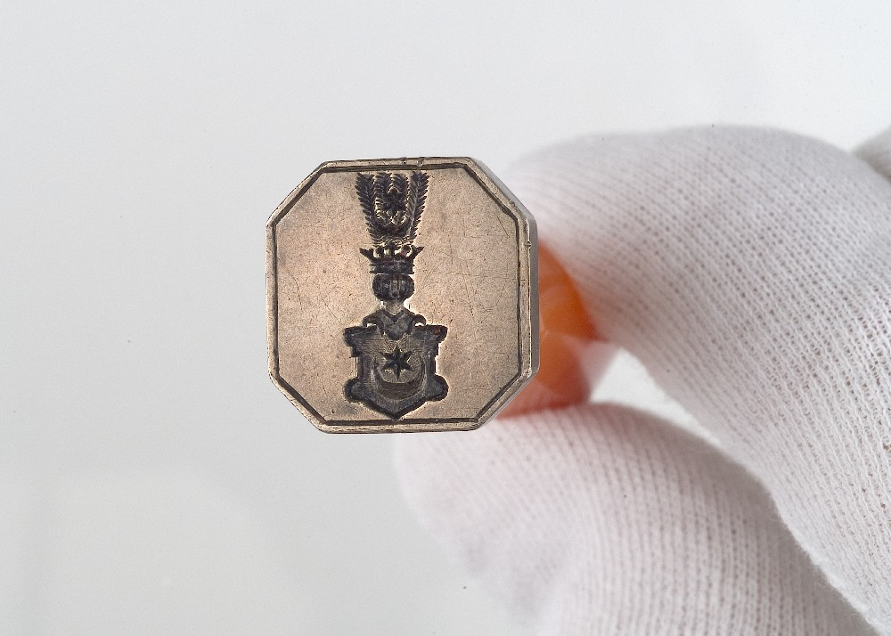
Not
“Not all of us can leave. Somebody has to stay here,
irrespective of the circumstances” Witold Pilecki

